Slide 1
Threads, concurrency, socket and networking in java
Understand Thread and Process
Multi-threading
Understand socket and networking
Understand tasks scheduling
Understand concurrency

Slide 2
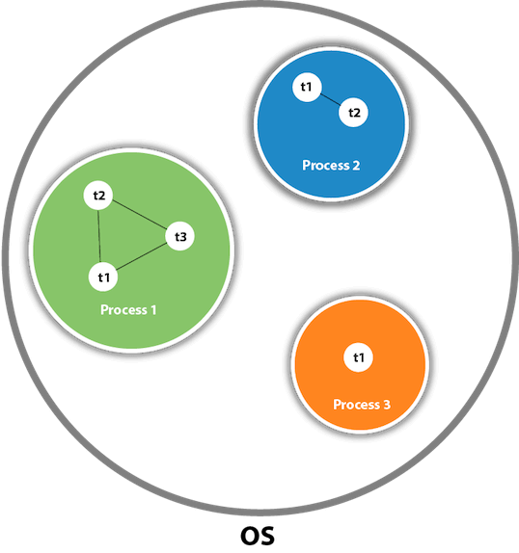
Thread and Process
What is java Thread ? :- in java, a thread refers to the smallest unit of execution within a process. A process can have multiple threads running concurrently each performing a distinct task. Threads allows a java program to perform multiple tasks simultaneously, making them particularly useful for tasks such as handling user input while performing background computations, managing network connections or handling asynchronous event.
Threads can be created by extending the Thread class or implementing the Runnable interface and passing It to a Thread object.
Threads are like little helpers inside your process, doing different jobs at the same time.
What is Multithreading ? :- multi-threading in java refers to the concurrent execution of multiple threads within a java program. A thread is a light-weight process that can perform tasks independently. Multi-threading allows java programs to execute multiple operations simultaneously, improving performance and responsiveness. Java multi-threading are mostly used in games, animation etc.
Why use java Multi-threading ? :- 1. it does not block the user :- threads are independent which helps to perform multiple operations at the same times.
2. it save times as it allows you to perform multiple operations at the same time. 3. threads are independent of each other, which means if there is an exception in a single thread it does not affect the other threads.

Slide 3
Thread and Process
Java threads methods :
1. start() --- it is used to start the execution of the thread.
2. run() --- it is used to do an action for the thread.
3. sleep() --- it sleeps a thread for the specified amount of time.
4. currentThread() --- it returns a reference to the currently executing thread object.
5. join() --- it waits for a thread to die.
6. getPriority() --- it returns the priority of the thread.
7. setPriority() --- it changes the priority of the thread.
8. getState() -- it is used to return the state of the thread.
getName() -- it returns the name of the thread.
Life cycle of a Thread (Thread states) --- in java a thread always exists in any one of the following states : 1. New. 2 .Active. 3. Blocked/Waiting. 4. Timed waiting. 5. Terminated.
Let's briefly explained the different Thread state :
New state -- a thread is said to exist in the new state whenever it is created, any thread that is in the new state means that the code has not been run yet and as such has not begun its execution.
Active state -- when a thread invokes the start() method, it moves from the new state into the active state. The active states contains two states runnable and running. Lets see what we meant by Runnable and Running

Slide 4
Thread and Process
What is Runnable ? :- a thread that is ready to run, is said to be in the runnable state. When a thread is at the runnable state, it is the duty of the thread scheduler to provide the time for the thread to run. When a program is implementing multi-threading, a fixed sliced of time is allocated to each individual thread to run for a short span of time after which the thread voluntarily gives up the CPU to the other thread so that they can also run for their slice of time. Whenever such scenarios occurs all those threads that are willing to run, waiting for their turn to run are in the runnable state.
What is Running ? :- when the thread gets the CPU, it moves from the Runnable to the Running state.
Blocked/ waiting state – whenever a thread is inactive for a span of time, it means the thread is either on the blocked or waiting state. E.g. lets say Thread A wants to print out some data from a printer, however at the same time another Thread B is using the printer to print out some data, Thread A will have to wait for Thread B to finish printing before using the printer, in that state, Thread A is in a blocked or waiting state, which makes it unable to perform any operations.
Timed waiting state --- is when a specific time is given to a thread when it is inactive so that It does not have to wait forever, assuming the thread it is waiting on have entered a critical section and it is not willing to leave, to avoid the other thread from waiting forever which will lead to starvation a waiting time is set for the thread so it does not stay there forever.
Terminated --- a thread will reach the termination stage when it has finished it's job, it will exit or terminate. A terminated thread means the thread is no longer in the system, in essence the thread is dead.

Slide 5
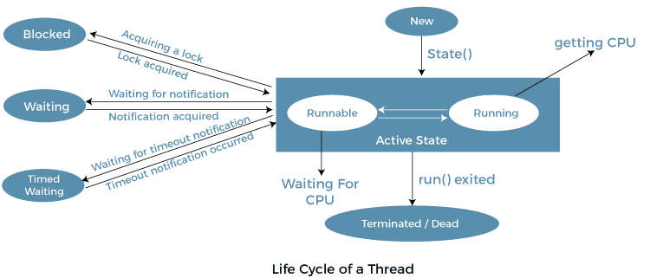
Thread and Process

Slide 6
Thread and Process
Class activity 1A – let's see a simple java program to demonstrate various thread state
How to create a thread in java ? :- there are two ways to create a thread:
1. By extending the Thread class. 2. By implementing Runnable interface
Thread class : Thread class provides constructors and methods to create and perform operations on a thread. The Thread class extends Object class and implements Runnable interface.
Some of the commonly used constructors of Thread class :
1. Thread()
2. Thread(String name)
3. Thread(Runnable r)
4. Thread(Runnable r, String name)
Some commonly used methods of Thread class:
1. run() -- it is used to perform actions for a thread.
2. start() -- starts the execution for the thread.
3. sleep(long ms) -- causes the currently executed thread to sleep (temporarily cease execution) for the specified number of milliseconds.
4. join() -- waits for a thread to die.
5. join(long ms) -- waits for a thread to die for the specified milliseconds.
6. getPriority() -- returns the priority of the thread
7. setPriority(int priority) -- changes the priority of the thread
8. getName() -- returns the name of the thread.
9. setName(String name) -- changes the name of the thread.
10. currentThread() --- return the reference of currently executing thread
11. getState() -- it is used to return the state of the thread

Slide 7
Thread and Process
Runnable interface : the Runnable interface should be implemented by any class whose instances are intended to be executed by a thread. Runnable interface have only method named. run() -- which is used to perform actions for a thread.
Starting a thread : the start() method of Thread class is used to start a newly created thread, which performs the following tasks :
1. a new thread starts(with new call stack).
2. the thread moves from the New state to the Runnable state
3. when the thread gets the chance to execute, its target run() will run
Class activity 2A -- let's see how to create a thread by extending a Thread class
Class activity 2A1 -- let's see how to create a thread by implementing Runnable
Having seen this two ways of creating a thread, the question now is which is better to use between both; extends a Thread class or implement Runnable? :
When creating a thread in java its often recommended to implement the Runnable interface, rather than extending the Thread class. Here is why:
1. Encapsulation :- by implementing Runnable you separate the task you want to execute from the thread management logic which follows the principles of separation of concerns, making your code cleaners and easier to maintain.
2. Flexibility :- implementing Runnable allows your class to extend other classes if necessary, seeing that java does not support multiple inheritance. By extending a Thread class, you already lose this flexibility because your class is already a thread.
3. Resource useage :- extending Thread consumes more system resources because each instance of thread has its own separate thread. But implementing Runnable on the other hand allows multiple thread to share the same runnable object which reduces resource consumption.
Class activity 3A -- Let's create a task where 2 threads print numbers from 1 to 5 and 6 to 10 to demostrate concurent execution:

Slide 8
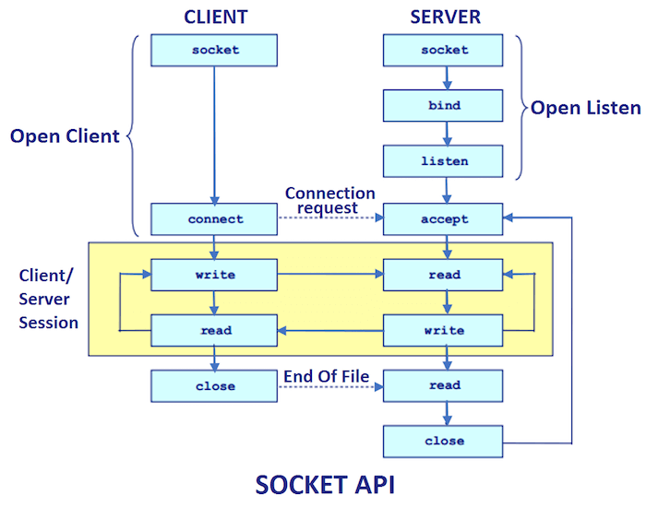
Socket and Networking
What is Socket programming in java ? :- socket programming in java refers to the ability to communicate between processes running on different computers over a network using sockets. A socket is an endpoint for communication between two machines. Java uses the java.net package to provide support for socket programming.
Here is a basic overview of how socket programming works in java :
1. Server socket :- a server socket is created on a specific port of the server machine. It listens for incoming connection from the client socket.
It waits for a client to connect and then established a connection with the client socket. Once the connection is established, data can be exchanged between the server and the client.
2. Client socket :- a client socket is created to initiate a connection with the server socket. It connects to the server socket on a specific host and port. After the connection is established, data can be sent between the client and the server. It must know two information : 1. IP address of server. 2. Port number.
Java socket programming can be connection-oriented or connection-less. Socket and ServerSocket are used for connection-oriented socket programming. While DatagramSocket and DatagramPacket are used for connection-less socket programming.

Slide 9
What is a port ? : A port in the context of computer networking and communication is a logical endpoint used for network communication. It is associated with an IP address of a host and the protocol type of the communication. Ports are used to identify specific processes or services that are available on a networked device, allowing different applications or services to share a single physical network connection.
Common port:
HTTP: 80
HTTPS: 443
FTP: 21
SSH: 22
SMTP: 25
DNS: 53
Telnet: 23
What is an IP Address : An IP (Internet Protocol) address is a unique numerical identifier assigned to each device connected to a computer network that uses the Internet Protocol for communication. An IP address serves two primary functions: host or network interface identification and location addressing. There are two types of IP addresses currently in use: IPv4 and IPv6.

Slide 10
Socket and Networking
Socket class :- a socket is nothing but an endpoint for communications between machines. The Socket class is used to create client socket. Important methods of the Socket class are :
1. getInputStream() -- returns the input stream attached to the socket.
2. getOutputStream() -- returns the output stream attached to the socket.
3. close() -- close the socket.
ServerSocket class :- it is used to create a server socket which is used to established communications with the clients. Important methods are:
1. accept() -- returns the socket and established a connection between server and client.
2. close() -- closes the server socket.
Syntax for creating a server application:
ServerSocket server = new ServerSocket(3000);
Socket socket = server.accept() // established connection and waits for the client
Syntax for creating a client application:
Socket client = new Socket("localhost", 3000);
Class activity 4A -- lets see a simple example of java socket programming (read only): In this example, the server listens for connections on port 12345. When a client connects, it reads a message from the client, prints it, sends a response back, and then closes the connection. The client connects to the server on localhost and port 12345, sends a message, reads the response, and then closes the connection.
Class activity 5A -- read and write from both ends
Class activity 6A – lets see a simple example to use all what we have learnt to help us understand the week 7 task

Slide 11
Thread scheduler
What is Thread scheduler in java ? :- thread scheduler in java is a component that decides which thread to run or execute and which thread to wait for. In java a thread to execute is only chosen by a thread scheduler if it's in the runnable state, however if there is more than one thread in the runnable state, it is up to the scheduler to pick one of the thread and ignore the rest base on some criteria like priority and time of arrival.
Priority :- priority of each thread lies between 1-10, if a thread has a higher priority, it means that thread have a higher percentage of being picked by the scheduler.
Time of arrival :- supposed two thread with the same priority enter the same runnable state, which will be picked first? In this scenario the priority will no longer be used as a factor, but the time of arrival of both thread will be used by the scheduler based on the thread that arrives first.
What is Daemon thread in java ? :- in java a daemon thread is a thread that runs in the background, providing services to non-daemon thread(user thread). The JVM exits when all non-daemon threads completes their execution. The JVM terminates when all the user thread dies.
Key characteristics of Daemon thread:
1. Background execution :- daemon thread are typically used for tasks that runs in the background and do not need to be explicitly stopped or join by the main application. They are often used for tasks such as garbage collection, monitoring, logging.
2. Automatic termination :- the moment the JVM determines that only daemon thread are running, it will automatically exits without waiting for this thread to completes their execution.
3. Low priority thread.
4. It's life depends on user thread.
Daemon thread methods: 1. setDaemon(boolean status) -- is use to mark the current thread as a daemon thread or user thread. 2. isDaemon() --is used to checked if the current thread is daemon.

Slide 12
Daemon Thread
Class activity 5A – let's see an example of a Daemon thread.
Why use Daemon thread ? 1. supporting services – they are suitable for background tasks or services that compliments the main application. E.g. logging.2. autonomous execution -- daemon thread allows certain task to run independently on the background without requiring explicit management from the main application. 3. efficient resource management -- they are ideal for tasks that need to perform resource cleanup or maintenance operations. 4. simplicity and convenience – provides a convenience way to manage background tasks without the need for complex termination logic. 5. garbage collection – garbage collections is a crucial steps in memory management and using daemon thread for this purpose ensures that it operates efficiently.
What is java garbage collection ? :- garbage collection is an automatic memory management process that runs in the background of a java virtual machine. Its primary purpose is to automatically reclaimed memory occupied by objects that are no longer referenced and unreachable by the program. It eliminates the needs for manual memory management such as explicit memory allocation and de-allocation as required in languages like C and C++.
Here's how Java Garbage Collection typically works:
1. Allocation of Objects: When you create objects in Java using the new keyword, memory is allocated on the heap to store those objects.
2. Reference Tracking: The JVM keeps track of references to objects. An object is considered reachable if it can be accessed directly or indirectly through a chain of references from the program's roots, which typically include local variables, static variables, and references from active threads.
3. Identification of Unreachable Objects: Garbage collection identifies objects that are no longer reachable by tracing references from the program's roots. Objects that are not reachable are considered garbage.
4. Reclamation of Memory: Garbage collection reclaims memory occupied by unreachable objects. It frees up the memory so that it can be reused for future allocations. The reclaimed memory becomes available for new object allocations.
5. Mark-and-Sweep Algorithm: One of the common garbage collection algorithms used by Java is the mark-and-sweep algorithm. This algorithm involves two phases: marking and sweeping. During the marking phase, reachable objects are marked as alive. In the sweeping phase, memory occupied by unmarked (dead) objects is reclaimed.
6. Generational Garbage Collection: Modern JVM implementations often use generational garbage collection, which divides the heap into different generations (e.g., young generation, old generation). Objects are initially allocated in the young generation, and a minor garbage collection is performed frequently to reclaim short-lived objects. Long-lived objects are eventually promoted to the old generation, where a major garbage collection may occur less frequently.
The gc() is used to invoke the garbage collector to perform cleanup exercise which is found in the System and Runtime class. The finalize() is invoked each time before the object is garbage collected
Class exercise 1A – peer-to—peer : Task: Write a simple program that simulates a countdown timer using threads.
Instructions:
Create a class named CountdownTimer that extends the Thread class.
In the CountdownTimer class, implement a method named run() that prints a countdown from a specified starting point (e.g., 10) to zero, with a delay of one second between each count.
In the main class, create an instance of CountdownTimer and start the thread.
After starting the thread, wait for it to finish using the join() method.
Print "Countdown complete!" once the countdown is finished.

Slide 13
Understanding java concurrency
How can object be garbage collected ? 1. by nulling the reference – by assigning a null to a value. 2. by assigning a value to another. 3. by anonymous object.
Class activity 6A – how to use garbage collection in java using a null reference.
What is java concurrency ? :- concurrency in java refers to the ability of a java program to execute multiple tasks concurently, which enhance efficient utilization of resources and improved performance. Java provides a built-in mechanism for concurrency via its multi-threading capabilities which allows multiple threads to run concurrently within a single program. Java concurrency can be achieved by either extending the Thread class or implementing the Runnable interface which allows us to create and managed threads. Moreoso java provides a higher-level concurrency utilities in the java.util.concurrent package which offers abstractions for task scheduling, synchronization and coordination.
Key aspects of java concurrency :-
1. Multi-threading :- java allows the creation of multiple threads within a single program where each thread represent a single flow of execution which enable concurent execution of tasks.
2. Thread sychronization :- in concurrent programs, multiple threads may access same resources concurrently which could lead to race condition and data inconsitencies. By using a synchronized block provided by java thread safety can be achieved.
3. Thread pools :- java concurrency utilities include thread pool implementations, such as ExecutorService and ThreadPoolExecutor which manages a pool of worker thread and facilitates the execution of tasks concurrently.
Why use java concurrency ? :- 1. utilization of multicore processors -- concurrency allows java aplication to take advantage of the available processing power by executing multiple tasks simultaneously on different core which can improve the overall performance of the application. 2. improved responsiveness -- concurrency allows java application to remain responsive and continue serving user requests even when performing long running or blocking operations such as I/O operations, network communication or database queries. 3. efficient resource utilization – concurrency helps optimize resource utilization by allowing java applications to make better use of available system resources.
In summary concurrency is used for building high performance, responsive and scalable applications that can effectively utilized modern hardware's and meet the demands of concurrent and distributed computing environment. It allows developers to write efficient, concurrent code that can take full advantage of multicore processors and distributed computing architectures.

Slide 14
Socket and Networking Cont.
Class activity 7A --- lets see an example that demonstrates how to use multiple threads to perform independent tasks concurrently.
What is java networking ? :- java networking refers to the set of APIs and libraries In the java platform that enable developers to create networked applications. With java networking capabilities, developers can build client-server applications, peer-to-peer systems, distributed systems and web applications that communicate over networks using various networking protocols. In talking about java Networking we must also discuss java Socket programming which provides us with the facility to share data between different computing devices.
Why use java networking ? :- 1. platform independent -- we can write networking application once and run them on any platform that supports java such as windows, mac, or any embedded system. 2. sharing of resources – java networking APIs supports interoperability with other systems and technologies which allows for easy integration with other java application with existing network infrastucture. 3. scalability – java networking supports asynchronous and concurrent programming models allowing you to build scalable and responsive networked applications that can handle multiple clients at the same time.
The java.net package supports 2 protocols : 1. TCP – stand for Transmission Control Protocol which provides reliable communication between the sender and the reciever. 2 UDP -- stands for User Datagram Protocol which provides a connection-less protocol service by allowing packets of data to be transferred along two or more nodes.
Java Networking terminology :- the widely used java Networking terminology are : 1. IP Address . 2. protocol. 3. port number. 4. MAC address. 5. connection-oriented and connection-less. 6.Socket.
What is an IP Address ? :- an IP Address stands for Internet protocol address, is a unique numerical label assigned to each device connected to a computer network that uses the internet protocol for communication. E.g 192.168.0.1. it consists numbers that ranges from 0 to 255 it could be static or dynamic. IP Address serves two main purposes in computer networking : 1. Identification. 2. Routing.
1. Identification :- an IP Address uniquely identifies a device over a computer network, similar to how a street address identifies a house or building in a city. Which allows other devices on the network to locate and communicate with each other.
2. Routing :- IP Address plays a crucial role in routing data packets across network. When data is transmitted over the internet or any network, it is divided into smaller unit called packets where each packets contains the source and destination IP Addresses.

Slide 15

Socket and Networking Cont.
What is protocol ? :- protocol refers to a set of rules and convention that govern the communication and interaction between two or more entities in a computer network. This rule determined how data is transmitted, received, interpreted and processed by devices connected to the network. Protocols ensures that data communication occurs reliably, efficiently and consistently across diverse network environments. Types of protocols – TCP. UDP, SMTP, FTP, HTTP.
What is port number? :- a port number is a numerical identifier used to distinguished between different communication endpoint in a computer network. Ports are associated with a specific IP processes or services running on a device which enable multiple applications to communicate simultaneously over a network. Example of well know ports : HTTP(port - 80) HTTPS(port - 443) SMTP(port – 25) FTP(port - 21)
What is java URL ? :- URL is an acronym for universal resource locator which points to a resource in the world wide web.It's a pointer to the location of a resource, such as a web page, file, or service, identified by its protocol, host name, port, and file path components.
A URL contains many information : 1 . Protocol – in the above image https is the protocol. 2. host name/IP Address --- www.javapoint.com is the host name. 3. port number --- this is optional if its not mentioned in the URL it returns –1. 4. file path -- the file the user is accessing

Slide 16
Socket and Networking Cont.
Java URL class methods :
1. getProtocol() – it returns the protocol of the URL.
2. getHost() -- it returns the host name of the URL.
3. getPort() -- it returns the port number of the URL.
4. getFile() -- it returns the file of the URL.
Class activity 8A – lets see an example of a java URL class to check the above methods
What is synchronization in java? :- in java synchronization refers to the process of controlling access to shared resources(like objects, variables, methods) among multiple threads in a multi-threaded environment to avoid data inconsitencies or corruption. When multiple threads try to access shared resources concurrently without proper synchronization, it can lead to a race condition – race condition occurs when the outcome of a program depends on the timing of thread execution.
Why used synchronization ? :- 1. to prevent thread inteference. 2. to prevent consitency problem. 3. prevent race condition. 4. to avoid deadlock.
There are 2 types of synchronization : 1. process synchronization. 2. thread synchronization. We will focus on thread synchronization.
What is thread synchronization ? :- thread synchroniation is the process of coordinating the execution of multiple threads to ensure that they access shared resources in a controlled and orderly manner. In a multi-threaded environment, where multiple threads execute concurrently, synchronization becomes crucial to prevent race condition, data corruption and ensure data consitency.
Some key aspects of thread synchronization :
Mutual exclusion :- one of the primary goal of thread synchronization is to enforce mutual exclusion, ensuring that only one thread can access a critical section of a code or shared resources at a time which prevents concurrent threads from interfering with each other's operation and maintain data integrity.
Synchronization mechanism :- java provides several synchronization mechanism to achieve mutual exclusion such as synchronized methods, synchronized blocks and explict locks.

Slide 17
Concept of lock in java :- synchronization is built around an internal entity known as the lock or monitor. Every object has a lock associated with it. Any thread that needs consistent access to an object field has to get the object lock before accessing them and then release the lock the moment it is done with them.
Class activity 9A – lets understand a problem without synchronization which will make our printout inconsistent:
Class activity 10A – lets correct the inconsistency by using a synchronized method

